Slide 1
Digital Marketing (Unit – 1)
by
Dr. Sunil Pratap Singh (Assistant Professor, BVICAM, New Delhi) 21th March 2022
Notes:
1

Slide 2
Digital Marketing: Definition
Digital Marketing (also called ‘Internet Marketing’, ‘Web Marketing’, ‘Online Marketing’) is defined as the promotion of brands or products through different forms of electronic media.
These forms could be:
Website
Blogs
Social Media
Mobile Applications
etc.

Slide 3
Evaluation of Digital Marketing from Traditional to Modern Era
Since 1450, when Gutenberg’s (German) printing press began its operation, till the present time when automated posting of online advertisements has become very common, marketing has kept up incredibly well with changing technology.
The original marketing concept and its orientations have shifted through various stages of evolution termed as ‘Marketing Eras’ –
Trade Era: Products were handmade; hence, supply was limited.
Production Era: Products were mass produced and consumers focused on features like low cost and availability.
Product Era: Focus moved from quantity to quality and consumers laid more emphasis on quality, performance, and innovative features.

Slide 4
Evaluation of Digital Marketing from Traditional to Modern Era
Sales Era: With increasing competition, companies were compelled to emphasize on aggressive selling and promotion, leading to saturation of consumer demand.
Marketing Era: Marketing emerged as a practice as consumers started demanding better products; differentiators like pricing, distribution, and promotion became important.
Relationship Era: Customers started getting valued to build a long-term orientation.
Digital Era: Also called the social/mobile era, the focus is on real-time and social exchange-based marketing where communication and social interactions play a prime role.

Slide 5
Evaluation of Digital Marketing from Traditional to Modern Era
Premise of Traditional Marketing
Traditional marketing includes platforms and techniques which were used as one-way communication tool rather than interactive ones. Important tools include:
Print Marketing (newspapers/magazines/catalogues) provided daily news, classifieds, local and interest-based periodicals/flyers which were monetized through promotions and local advertisements.
Broadcasting (television/radio) provided entertainment, knowledge, and live events, primarily supported by television advertisements.
Home Marketing (billboard also called a hoarding) has had great impact over decades in terms of influencing consumers.
One-to-One Marketing (telemarketing) has been effective though expensive.

Slide 6
Evaluation of Digital Marketing from Traditional to Modern Era
Main Factors Impacting the Shift from Traditional to Modern Marketing
Growing amount of communication channels.
Consumers’ preference for interactive rather than traditional medium like newspapers, magazines, TV, which have a one-way information flow.
Need to validate marketing with product and service recommendations from trusted group of influencers/social interactions.
Need for comparison of product benefits to make informed decisions.
Higher interaction with products and more avenues for such interactions facilitating holistic messaging rather than the traditional practice of one-off marketing.

Slide 7
Evaluation of Digital Marketing from Traditional to Modern Era
Advent of Modern Marketing Techniques
Modern marketing involves the following platforms and techniques:
Search Marketing: Using search technology towards marketing
Online Advertising: Placing ads across websites/digital platforms
E-mail Marketing: Sharing commercial messages with people
Social Media Marketing: Using social media platforms/networks for marketing
E-commerce: Selling/trading goods and services on any online platform
Digital on Traditional Mediums: Integrating digital technologies with traditional marketing mediums to improve interactivity (set-top box for TV can be integrated with Internet-enabled features to support digital sales)

Slide 8
Evaluation of Digital Marketing from Traditional to Modern Era
Rise of the Internet:
The transition from traditional to modern marketing has occurred over a period of time on the basis of fundamental technological changes impacting marketing.
Most of them, undoubtedly, have been the invention of the Internet and its wide application to business marketing.
The concept of Internet impacted the basic manner in which information would be stored and distributed globally through the concepts of communication protocols and networking.
Creation of e-mail and World Wide Web (WWW) were the most important advancements which brought out the power and influence of the Internet and related it to common man’s needs for communication and information.

Slide 9
Evaluation of Digital Marketing from Traditional to Modern Era
Rise of the Internet: (contd…)
World Wide Web Leading to an Explosion of Information Share
The invention of the Internet led to a large-scale economic boom never witnessed before.
The evolution of WWW brought with it the development of HTTP which is the foundation of data communication for the WWW.
HTTP functions as a request–response protocol in the client–server computing model.

Slide 10
Evaluation of Digital Marketing from Traditional to Modern Era
Rise of the Internet: (contd…)
Emergence of Websites and the Concept of URL
WWW started facilitating the display of text and images through websites (web pages).
A website is typically hosted on at least one web server and is accessible through an Internet address known as the URL.

Slide 11
Evaluation of Digital Marketing from Traditional to Modern Era
Rise of the Internet: (contd…)
Dotcom (.com) Era and the Phenomenon of Modern Marketing
Modern marketing began to create and use web pages to build virtual information centers for their products and brands, primarily for information dissemination and also to become the first movers to adapt technology as a part of their marketing activities.
With websites started to be developed at a rapid scale, each individual/firm would need to create a unique name or URL which would become the address for its online venture.
Several companies started setting up virtual shops in the hope that a large part of their business would start functioning online through these websites.
Throughout this mayhem, the biggest positive takeaway was that digital marketing, as it is known to be today, got defined and established.

Slide 12
Evaluation of Digital Marketing from Traditional to Modern Era
Rise of the Internet: (contd…)
Post Dotcom: Creation of Internet Business Models
During Dotcom Era, a lot of companies understood that digital plays a supportive role in marketing and sales would primarily be driven through physical models, a thought that would eventually change in the subsequent decade.
A lot of positives were being registered on the Internet timeline.
For ex., In 1995, Amazon.com bookstore had appeared. Sergey Brin and Larry Page were planning the future Google. Microsoft Internet Explorer appeared in 1996 and Hotmail came up for e-mail.
Internet started to impact the daily lives of its consumers laying the foundation of business to consumer (B2C) as a prominent online business model.
The biggest impact at this point of time was the emergence of search.

Slide 13
Evaluation of Digital Marketing from Traditional to Modern Era
Rise of the Internet: (contd…)
Growth and Impact of Search Technologies
The biggest impact which Internet had on marketing can be attributed to the rise of search technologies.
Research on search computing had begun as early as 1990 with the launch of WebCrawler, the first full-text web search engine, in 1994.
The following years saw the emergence of a lot of competing search engines including Excite, Infoseek, Inktomi, Altavista, Yahoo, Google.
Google’s Page Rank patent was a technological revolution (also a business innovation) which changed the way marketing could be approached on the Internet.
The impact of search technology is pivotal to digital marketing.

Slide 14

Origin of Digital Marketing
In 1994, the first banner ad was appeared on the first commercial web magazine, HotWired (now Wired.com).
Since then, the digital advertising market has evolved.
In 1996, the United States’ digital advertising market was worth $301 million.
In 1997, the market experienced phenomenal growth touching the figure of $1 billion.

Slide 15
Origin of Digital Marketing (contd…)
Around 1997, companies began thinking about placing advertisements on related websites and linking their pages to the banners.
In 1998, HotWired started selling banner advertising space to companies and achieved a sensational 30% Click-Through Rate (CTR).
Click-Through Rate = (Total Clicks on Ad) / (Total Impressions) * 100
Search engine, Yahoo!, adopted this idea by offering advertising space on its homepage.
Google launched its advertising platform called AdWords in the year 2000 to provide advertisers a sponsored link of their websites.

Slide 16
Origin of Digital Marketing (contd…)
LinkedIn launched in 2002, Facebook launched in 2004, Twitter launched in 2006. The social media attained penetration worldwide.
Alongside, revolution was happening in mobile with smartphone prices dropping sharply, enabling greater penetration among masses. The penetration of Internet also increased during the period.
Hence,
The decade of 1990s was fueled by display advertising.
The early part of decade 2000 was fueled by search advertising and later part by social media.
The decade 2010 was fueled by mobile.

Slide 17
Traditional versus Digital Marketing
Traditional marketing is spray and pray, wherein a marketer spreads the message among many audiences and hopes that some will be in the market to buy the product.
Digital marketing can be targeted to specific audiences who have interest in the product, and, hence, are already in the market to buy those products.
There is a saying in mass media “Half of advertising is waste. But, I don’t know which half.”
Digital marketing overcomes this limitation of mass media as it eliminates wastage.

Slide 18
Traditional versus Digital Marketing
Parameter | Traditional Marketing | Digital Marketing
Direction of Communication | Unidirectional (one to many) Information spread by company (active) Consumers only listen (passive) | Multidirectional (many to many) Both, company and consumers talk and listen (both active) Consumers can also create content, like or post.
Scheduling | Long-term (Ad campaigns are planned for a long period of time) | Short-term (Ad campaigns are not planned in detail but reactions to comments and requests are given)
Availability | During working hours | All the time (24 x 7)
Response Time | Longer; even if somebody is interested after seeing an ad in print or on TV, he/she cannot see additional information at that instant | Quickly; as soon as the anybody see the ad, he/she can click the link and get more information instantly

Slide 19
Characteristics of Digital Marketing
Digital marketing creates a level playing field for all the marketers as it does not distinguish between small and large businesses.
The cost of failure is low in digital marketing. Even if the campaign does not work, we will know immediately and can take corrective action.
It is a smart strategy to be bit edgy and try new ideas and different mediums of digital marketing to check out what works and what does not.
Digital marketing is like walking in the fog. Visibility is there only for the first 10 meters. If we want more visibility, we must walk the first 10 meters to be able to see next 10 meters. Hence, instead of waiting for the perfect blueprint, we can start digital marketing and learn on the go.

Slide 20
Emergence of Digital Marketing as a Tool
The marketing function has changed over the years in terms of the most important parameter — customer interaction.
Customer interaction can be defined as the manner in which any customer gets to know or interacts with any product or service with the intention of gaining information or to respond to the marketer’s goal of considering him/her as a consumer and finally convincing to buy the products.
Any consumer, in a reactive or proactive mode, typically looks to obtain information on any specific area of interest.
He/she might not be looking at a product or a service itself but information which would solve any one of the problems at hand.

Slide 21
Emergence of Digital Marketing as a Tool (contd…)
In the traditional form of marketing, the information to be delivered to consumers is decided, selected, or created by a group of experts who took the decision of:
what knowledge would be circulated, printed, or broadcasted (in the relevant examples of newspaper, magazines, radio, and TV),
which format it would be shared, and
at what price would it be delivered?
The consumer is more of a passive receptor of information (in certain feedback columns or radio programs, the consumer could raise some questions).
The consumer gains information and knowledge pre-curated for him and packaged with advertisements and promotions which he had no control over and maybe not much interested either.

Slide 22
Emergence of Digital Marketing as a Tool (contd…)
The successive marketing concepts till the present digital marketing era relate most to the manner in which the power of consumer choice has shifted from being a tame receptor to an active seeker of information.
The heart of digital marketing lies in this active seeking of information process.
Any type of customer interaction with any digital media can be divided into two types:
Medium-initiated Contact (Push Marketing)
Consumer-initiated Contact (Pull Marketing)

Slide 23
Emergence of Digital Marketing as a Tool (contd…)
Medium-initiated Contact (Push Marketing)
This is the traditional type of marketing where marketing messages are packaged with information pre-configured for a particular set of users.
Example: Newspaper - typically provides current information packaged across different verticals like politics, economics, sports, etc., along with large ad columns which bring in the revenue (along with the classifieds).

Slide 24
Emergence of Digital Marketing as a Tool (contd…)
Consumer-initiated Contact (Pull Marketing)
In this approach, the consumer places his intent and specific interest for a particular type of information, and being offered that information along with relevant marketing messages suited to his intent, query, or profile-based interests.
Example: Online Newspaper Portal - Each article of the newspaper is tagged and categorized based on multiple criteria to be searched upon a digital platform.
When a consumer makes a specific search for a piece of content and chooses matching news, promotions are sent based on his profile preferences, real-time location, and the topic of the article he found interested in reading.

Slide 25
Emergence of Digital Marketing as a Tool (contd…)
Push and Pull Marketing in Digital Marketing
Digital marketing includes all those techniques and concepts that utilize the intent (pull-based) action of the consumer to market products and services (in a push-based manner) which would be most needed, relevant, and of interest to him/her.
Digital Technologies with the Combination of Pull–Push Marketing Concepts:
Search Marketing: Consumers express their intent towards finding a particular piece of information and building a push marketing-based business around that search.
Display Advertising: Display advertising is built on pulling data from consumers’ readership interests on website wherein display ads were pushed next to the content being read.
Social Media Marketing: The intent of customer and his/her social networks are marketed back in the form of sponsored and native advertisements.

Slide 26
Drivers of New Marketing Environment (contd…)
Emergence of Internet
With growing availability of the Internet, it became possible to access information as and when required.
Rise of Millennial Generation (Generation Y)
People born during 1990 (having differing attitudes and aspirations) consider digital as a major buying platform.
Technology Advancements in Devices
Technology advancements in devices have brought convenient and feature-rich platforms like mobile, PDAs, tablets, which have made it possible to execute research, personal interactions, and commerce, all on the go.
Advancements in Design/UI
Rising Global Economies
With rising global economies, it has become easier for a large middle-class population to consume smartphones and tablets at prices never thought before.
Also, with the rise in education levels and increasing accessibility, the effect of digital is reaching far and wide to even smaller towns and cities, thus increasing the consumer net rapidly.

Slide 27
Digital Marketing Strategy
Consumer Decision Journey
The consumers, even after the purchase, remain engaged and promote the purchased product amongst their friends, family or colleagues if they are satisfied with the product.
The basic AIDA (Awareness, Interest, Desire, Action) model of marketing applies to digital marketing also, for consumer decision process.
The consumer moves through successive stages in the buying process.

Slide 28
Digital Marketing Strategy (contd…)
Awareness
Awareness is the first step and most important step in the buying process.
Without Awareness, the consumer will not consider the brand for purchase.
Digital marketing can play an important role in creating awareness.
To create awareness among consumers, advertisements can be displayed on websites and social media platforms.

Slide 29
Digital Marketing Strategy (contd…)
Interest
It is not enough for a marketer that a consumer is aware of the brand.
Consumer must be interested in the brand. They must want to know more about the brand. This is only known as ‘consideration stage’.
The consumers must consider the brand for purchase and it must be included in their consideration set. The consumers consider the brands that they have heard about or have seen their friends using it.
Interest can be sparked by running highly creative campaigns, interesting posts highlighting the unique benefits of the brand, and highly emotional messaging.

Slide 30
Digital Marketing Strategy (contd…)
Desire
Smart marketers assist consumers in the evaluation process by providing comparative analysis, economic value calculations, collecting feedback, reviews and ratings, and guiding consumers which can help them in making choices.
For example, De Beers educates consumers about what criteria to look for while selecting diamond. It emphasizes on four Cs - Carat, Colour, Clarity and Cut.
Some appropriate digital channels for this stage are community forums, blogs and review rating sites.
Based on evaluation of different brands, the consumers develop preferences for certain brands and such brands become part of the choice set.

Slide 31
Digital Marketing Strategy (contd…)
Action
In this stage, the consumers purchase the product they desire and prefer.
Having conveniently located retail outlets or online purchase facility will help the consumers in making the purchase.
The website should have smooth navigation so that consumers can easily find products that they are looking for.
Consumers may drop off at any stage as they may not like the design of the site or it may be slow to load or they may not find the right variant of the product or may be seeking discount or payment may not go through.
Marketers must ensure that all the hurdles are removed.

Slide 32
Digital Marketing Strategy (contd…)
Traditional AIDA model has only four stages as marketers have not given importance to post purchase.
With the advent of digital marketing, ‘Advocacy’ stage has become important in influencing other consumers and building loyalty.
Advocacy
Consumers experience satisfaction or dissatisfaction after purchase. They may share their experience on social media and spread word of mouth.
Social media is most appropriate for advocacy and word of mouth post purchase.

Slide 33
Digital Marketing Strategy (contd…)
P-O-E-M Framework
P-O-E-M (Paid, Owned, and Earned Media) framework helps us in organizing our digital marketing strategy.
Paid Media
It includes sponsored advertisements in different channels of digital marketing such as search engines, websites, Facebook, LinkedIn and Twitter.
Campaigns are run through different platforms such as Google AdWords and Campaign Manager of Facebook, LinkedIn and Twitter.

Slide 34
Digital Marketing Strategy (contd…)
Owned Media
It is an asset of the company i.e., the company has the ownership of media.
It includes company’s official website, microsite, and social media pages such as Facebook page, LinkedIn page, YouTube channel and Twitter handle.
It also includes mobile apps or blogs.

Slide 35
Digital Marketing Strategy (contd…)
Earned Media
It includes publicity that is generated through recommendations and word of mouth.
It also includes social media engagements such as likes, shares, comments, replies, retweets, favourites, etc.
Each media is generated by the users and hence is more credible and has the power to give exponential reach to the marketer.
The combination of ‘paid, owned, earned media’ is regarded as one of the best practices in digital marketing.

Slide 36
Digital Marketing Strategy (contd…)
There should be balance among all the media and there should not be lopsided towards one.
A simple thumb rule is to divide the budget between paid and owned/earned media.
Allocate 50% of digital marketing budget to create contents for digital assets and getting engagement, and remaining 50% on running paid ads.
The owned and earned media are organic and more credible, and provides higher quality traffic. They take longer time to show results. Hence, owned and earned media should be part of long-term strategy.
Paid media increases the brand reach and impressions in short-term.
The best practice is to strike a balance b/w long-term and short-term mediums.

Slide 37
Digital Marketing Strategy (contd…)
In India, the marketers tend to focus more on paid media and less on investing in creating quality contents; and budget is sometimes as high as 75% for paid media.
The distribution of budget is also a function of the stage of a brand in its lifecycle.
If the brand is in the introduction stage, it needs more awareness which requires more reach and impression and that too within a short period.
Hence, more budget can be allocated at the introduction stage to paid media.
However, if the brand is already known and is in the maturity or growth stage, it needs not rely on paid ads to great extent. Thus more budgets can be allocated to owned/earned media.

Slide 38
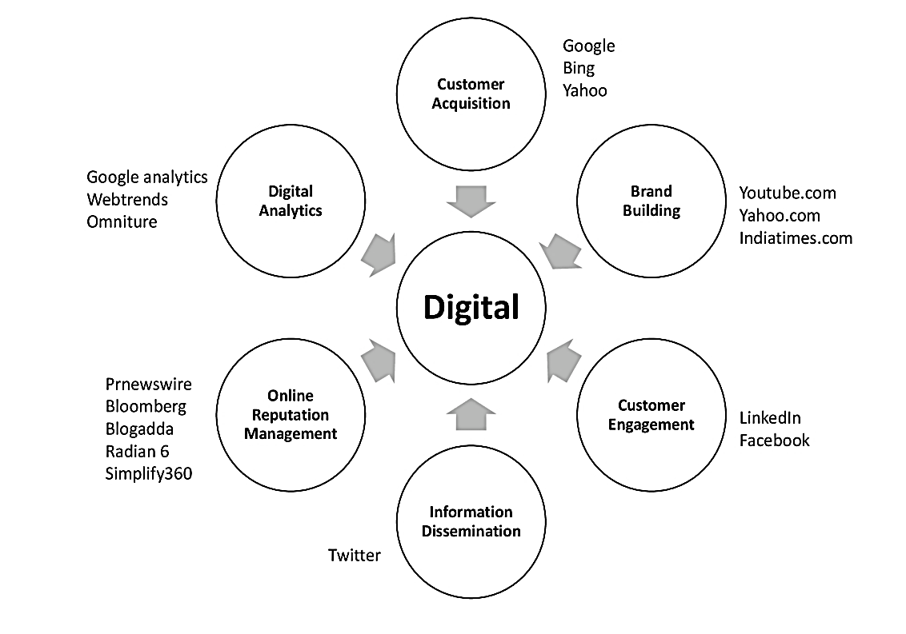
Digital Landscape
Digital marketing consists of different channels such as search engines, social media, mobile marketing, influencer marketing, etc.

Slide 39
Digital Landscape
Search engine marketing, done either through paid advertising or search engine optimization, is good for customer acquisition.
Users, interested in finding out information about a product or service, type a query on search engine.
The user is more likely to click and take the desired action based on the search engine results.
The click-through rates of search engines are highest among all other digital channels.

Slide 40
Digital Landscape (contd…)
Popular portals and websites (such as Yahoo!, Indiatimes and YouTube) are very good for brand building.
The first step in brand building is creating awareness.
These websites or mobile applications have millions of unique users and page views per month, and hence have huge reach.
If we place banner ad on such popular websites, it will reach large number of users, thus creating awareness.

Slide 41
Digital Landscape (contd…)
Social media is very apt for customer engagement as it is about building a community and nurturing a bond with members.
It is not so apt for generating sales or conversions as users do not come to social media to buy products or service but to engage with friends.
Each medium of digital marketing has its own unique strengths and characteristics.
Hence, marketing objectives must be aligned to each medium’s unique characteristics.

Slide 42
Digital Landscape (contd…)
Micro blogging platforms such as Twitter are apt for disseminating information rapidly.
Such platforms are good for trending and for spreading word of mouth.
Online reputation management (ORM) is a strategic area of digital marketing which is about listening and understanding consumer sentiments and proactively shaping the brand attitude.
Many social listening tools are available such as Radian 6, Simplify 360, that identify the influencers, brand associations and sentiments.
Another aspect of ORM is the ‘Digital PR’ which is fast replacing the ‘Traditional PR’.

Slide 43
Digital Landscape (contd…)
Digital marketing generates lot of digital analytics and metrics.
Measurability is one of the strengths of digital marketing.
Looking at the metrics and improvising our digital marketing strategy helps in improving Return on Investment (RoI).
Many tools are available for digital analytics through which performance of each campaign can be measured and optimized.

Slide 44
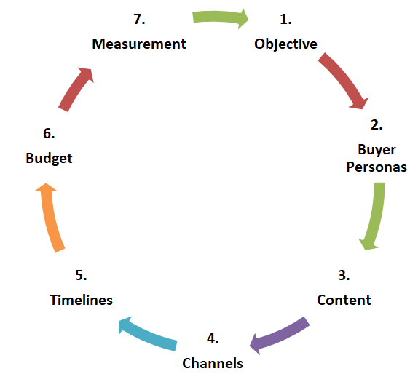
Digital Marketing Plan

Slide 45
Digital Marketing Plan (contd…)
Objectives:
Some campaigns and activities may have the objectives of increasing brand awareness where others may have the objective of increasing sales or leads.
Alongside objective setting, appropriate metrics should be identified for measurement of performance.
If the goal is branding, then the metric would be recall.
If the objective is performance, then measurement can be done through metrics such as Click Through Rate (CTR), Leads, Conversions, Cost Per Acquisition (CPA).

Slide 46
Digital Marketing Plan (contd…)
Buyer Personas:
Identify multiple buyer personas based on the analysis of past data and profile of our best customers.
The information that we need about our customers can be categorized into:
Who: Identify the age, gender, location, job title, responsibility, education of customer.
What: What are the goals of our customers, and what are their pain points that need to be resolved. Also, identify their areas of interest, media they consume, and touch points.
Why: We must question why they will buy our product, what is our unique selling proposition, what is our elevator pitch, and how compelling it is to convince the customer to buy.

Slide 47
Digital Marketing Plan (contd…)
Content:
Prepare content strategy by analyzing what worked in the past and what did not.
Analyze the performance of each of content type such as: Video, Image, Infographics, eBooks, Webinars, Games, and create more of the variety that performed better.

Slide 48
Digital Marketing Plan (contd…)
Channel:
How would we plan for creating paid, owned, and earned contents?
In owned, will we have a website or a microsite?
Which social media pages or handles will we have and how will we prioritize?
For earned media, will we participate in blogs or forum or question-answer sites?
Will we use contests or promotions or controversy or emotional appeal?
For paid media, which platform we will use for campaigns (will we run campaigns on search engines of banner ads on Facebook, Twitter or LinkedIn?

Slide 49
Digital Marketing Plan (contd…)
Timelines:
Prepare a month-wise calendar to record which activities will be done in which month?
Further, break down content strategy, channel strategy, target audience week-wise so that there is a starting point to refer to.

Slide 50
Digital Marketing Plan (contd…)
Budget:
How much budget we will allocate to digital marketing?
It depends upon what percent of the marketing objectives will be met through digital mode?
For certain industries such as e-commerce, financial services, automobile and education, digital marketing is important and hence higher percent budget may be allocated for digital marketing.
How much budget will be allocated for paid campaigns across different medium?
How much budget will be allocated for content creation?
How much budget will be allocated for technology development cost such as developing a website or game?

Slide 51
Digital Marketing Plan (contd…)
Measurement:
The measurement metrics will be dependent upon the objective.
If the objective is branding then measurement will involve recall, attitude and association studies.
Market research agency can be hired online or offline for measuring the effects of digital marketing.
If the campaign objective is performance then measurement is CTR, leads, and conversions.

Slide 52
Thank you
Notes:
52

